Slide 1
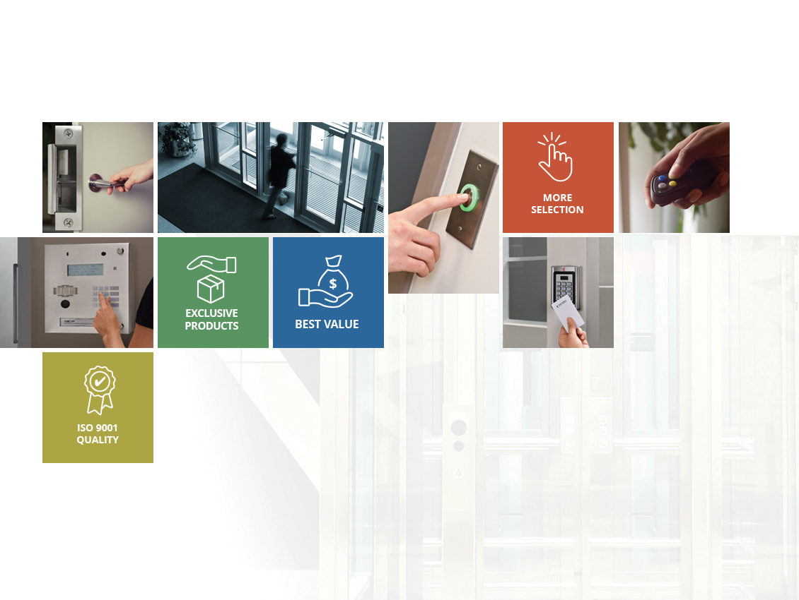
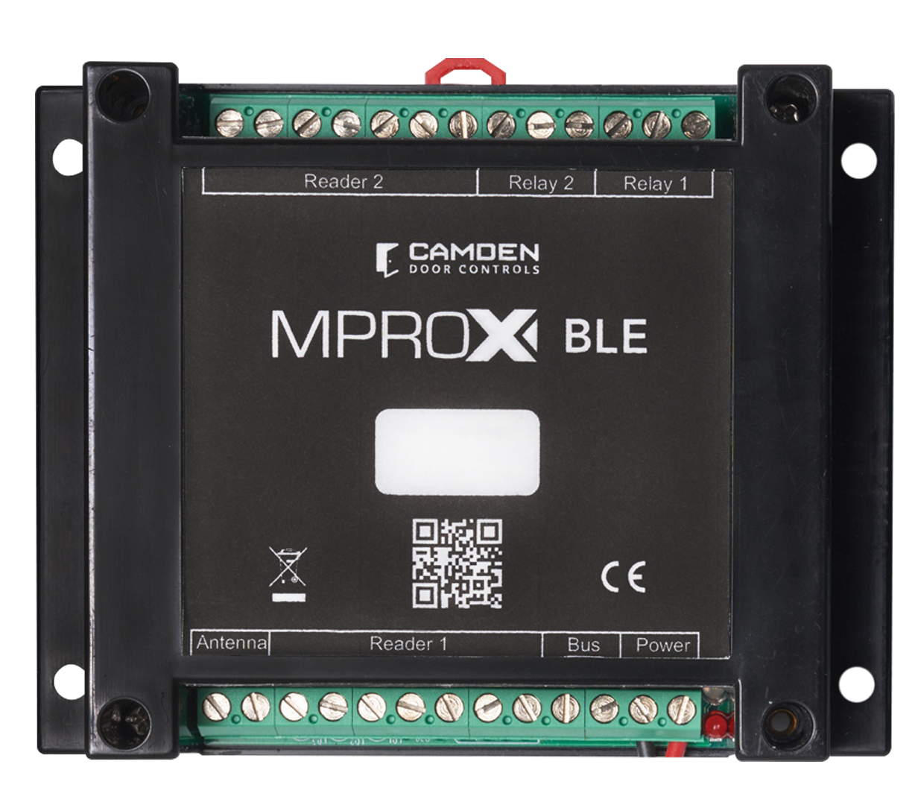
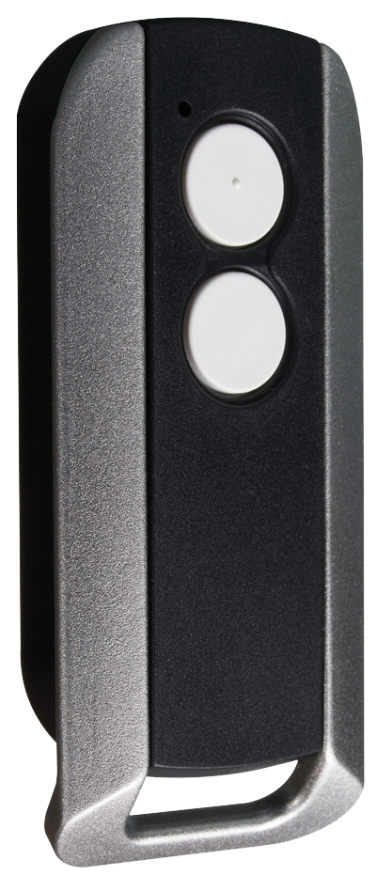
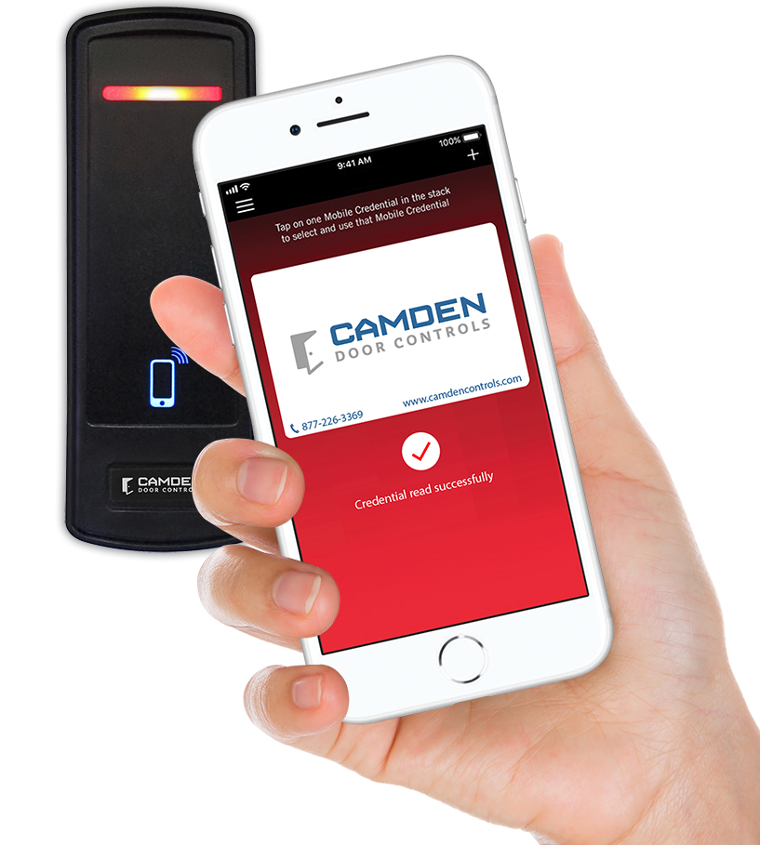
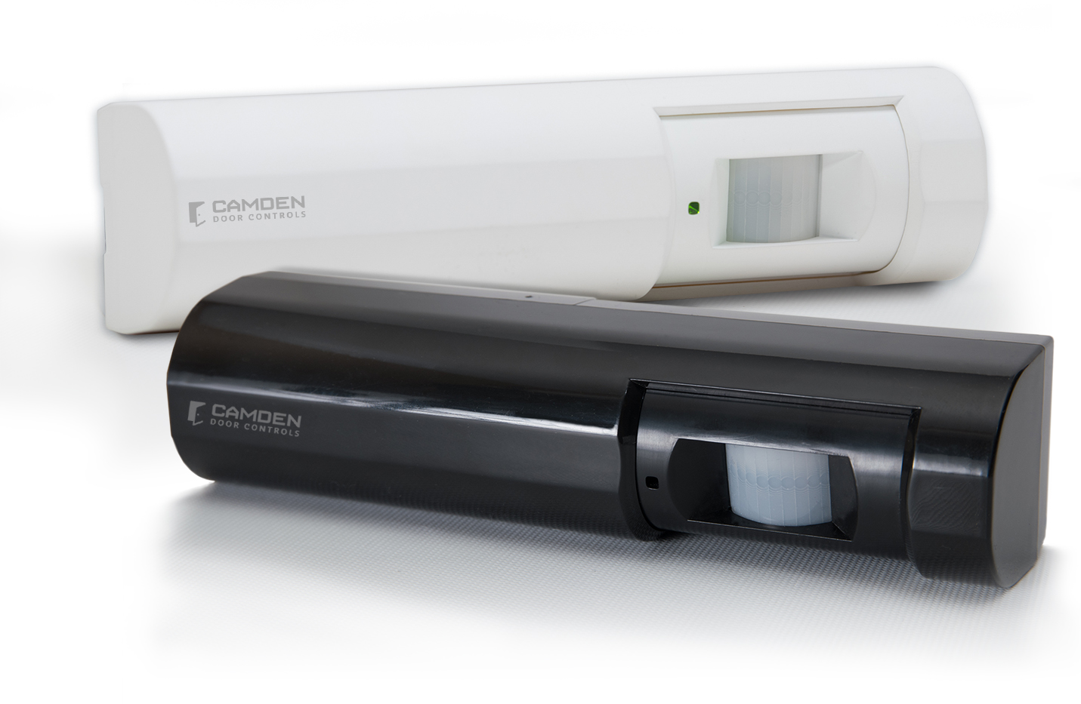
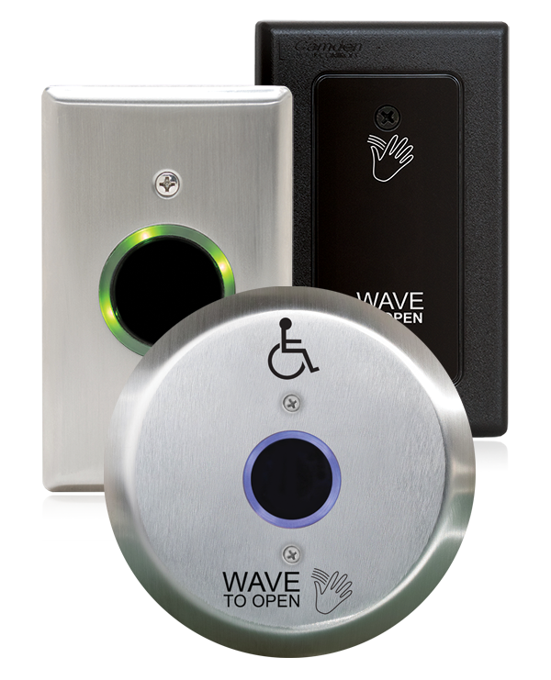
MPROX-BLE STAND-ALONE SINGLE DOOR CONTROLLER
JUNE 2021

Slide 2
CONTACTLESS/ FRICTIONLESS ACCESS CONTROL
THE NEW NORMAL
Notes:
The new norm of access control demands for a contactless solution. The MProxBLE accommodates these latest requirements.
Applications: Private washrooms, inventory rooms, parking lot, fenced in yards, small offices or stores, etc.

Slide 3
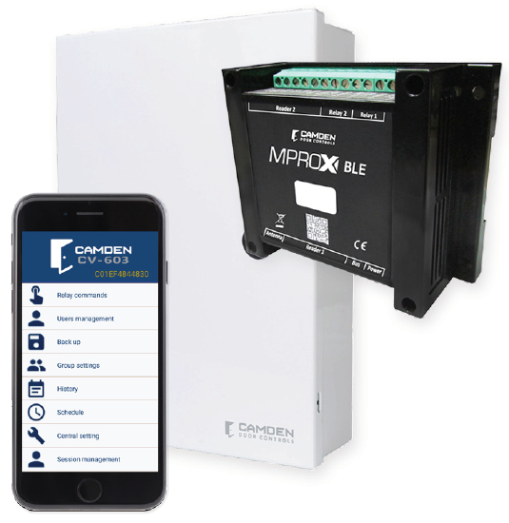
BYOD ACCESS CONTROL
Extremely easy and simple stand alone access control
No PC or monthly IP services required
No extra receiver required for long range transmitter
Compatible to all Wiegand readers
Notes:
Features:
Configured via iOS or by Android devices.

Slide 4
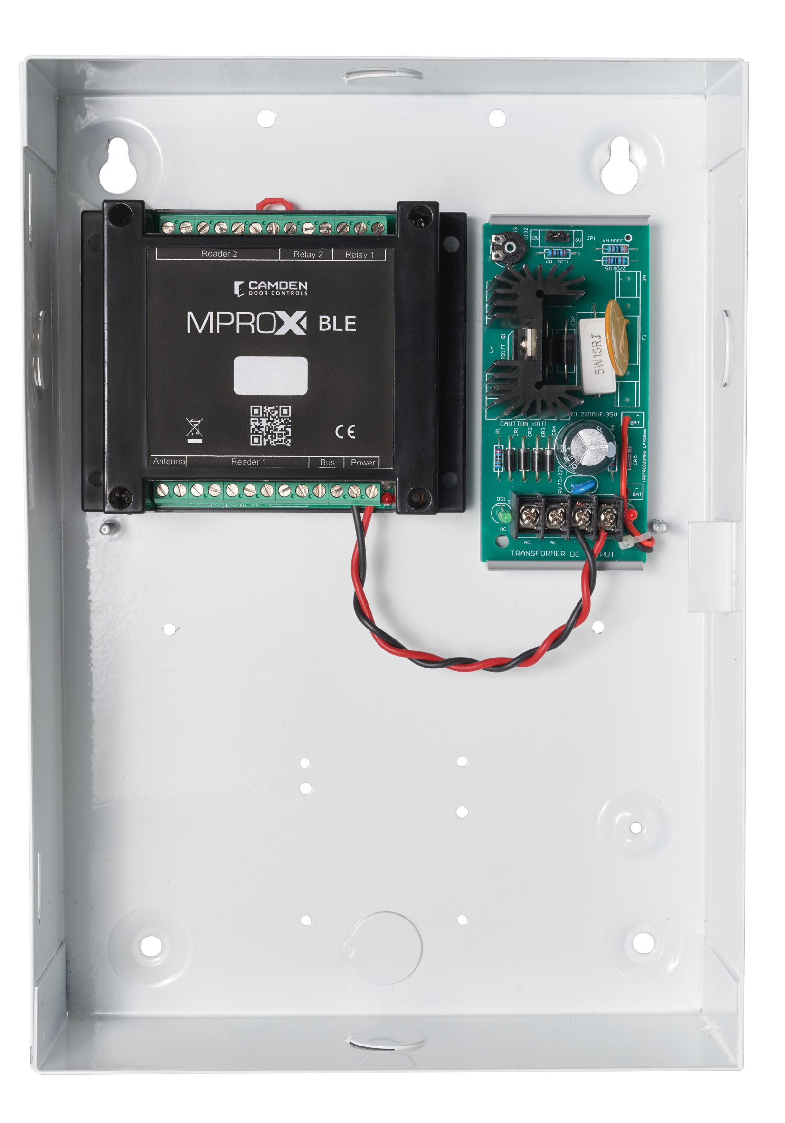
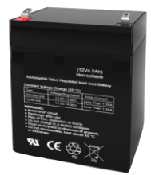
8-1/16” x 11-5/15” x 3-1/8”
Model: CV-603 - Controller Only
Model: CV-603PS - Controller cabinet with power supply and plug in transformer
Model: CV-603PS-K1 Kit Includes: - MProx-BLE controller - Lockable metal cabinet - 12 VDC battery back up power supply - 16 VAC plug in transformer - CV-7400 proximity card reader and key tag
Key tag
Notes:
8 1/16” wide x 11 5/16” high x 3 1/8” deep. – lockable cabinet, lock provided separately.
A 12 VDC, (1.5 Amp without battery backup) UL power supply. 130 mA charging current for 4AH rechargeable battery supplied separately. {Powered for two days with a card reader and still energized our CX-ED1079 door strike}

Slide 5
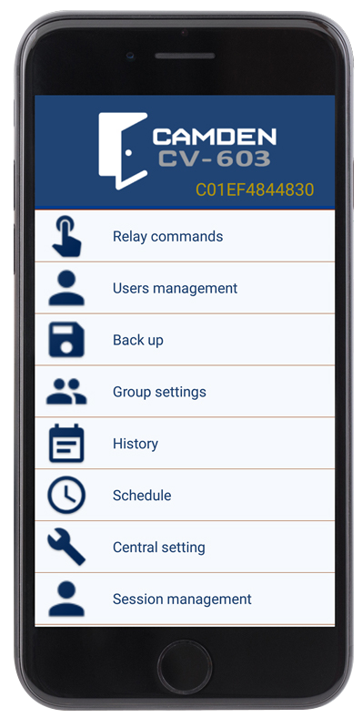
Local Alarm Annunciator
Controller Cabinet
Card Reader
Credentials
No dedicated PC required
No monthly subscription services
No proprietary card readers
BYOD configurator
UNIQUE
FEATURES
Alarm notification

Slide 6
CONTROLLER HARDWARE CONNECTIONS
Two Card Reader Ports - 26, 30, 34 and 37 Wiegand formats
DC Power - 12 VDC, < 100mA
Relay 1 - Form C, Door hardware control
Relay 2 - Form C, Door hardware & alarm
Antenna - 433Mhz. for two button transmitter
Notes:
Built-in 433 MHz encrypted receiver and a ClassII Bluetooth transceiver. Relays are rated at 1 Amp, 30 volt to control both 12 and 24 volt door strikes or maglocks.

Slide 7
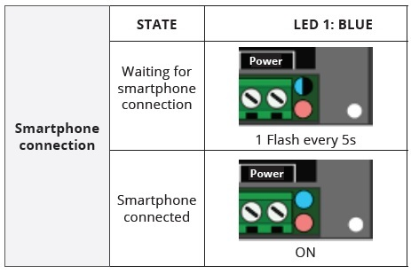
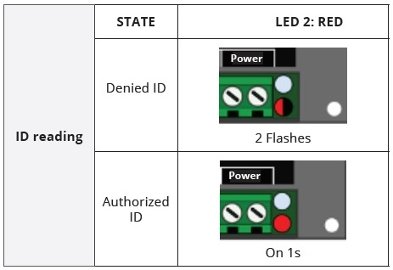
LED VISUAL INDICATORS
Quick and easy confirmation and diagnosing
Notes:
Power Supply LEDs; red for AC power, green for DC power.
The Controller LED; blue and red flash pattern provides visual confirmation. Notice the 2 red flashes when a credential is denied, and the door relay is not energized versus a one second, ON red LED when access is granted.
The blue, one second blinking confirms the controller is on standby and ready to accept a Bluetooth device with the MProxBLE app.

Slide 8
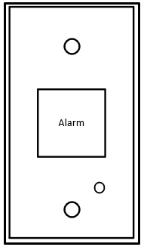
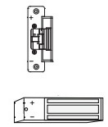
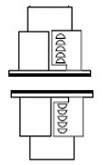
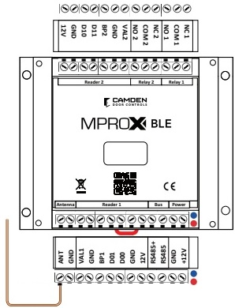
Two Card Reader Ports - IN/OUT Anti-pass back
Request to Exit - PIR Wave to Exit or Above Door Detector
Door Position Switch - Concealed or surface mount or latch monitor
Door Hardware - 12 VDC Door Strike or Mag lock
Alarm Annunciation - Local or Remote
Long Range Access - 433Mhz. encrypted 2-button transmitter
Notes:
Central Setting = Equipment Name, Anti-pass back, Daylight savings time, credential facility code.
Session Management = Select what information each 5 users see when they log in. User Management, Backup, History, Relay Commands, Schedule, Group Settings.

Slide 9
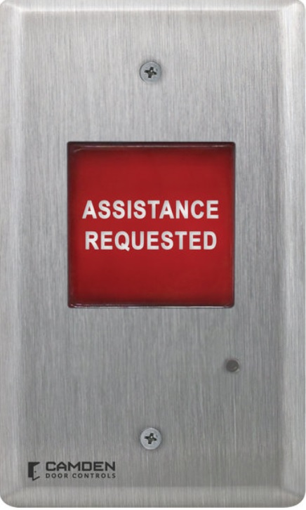
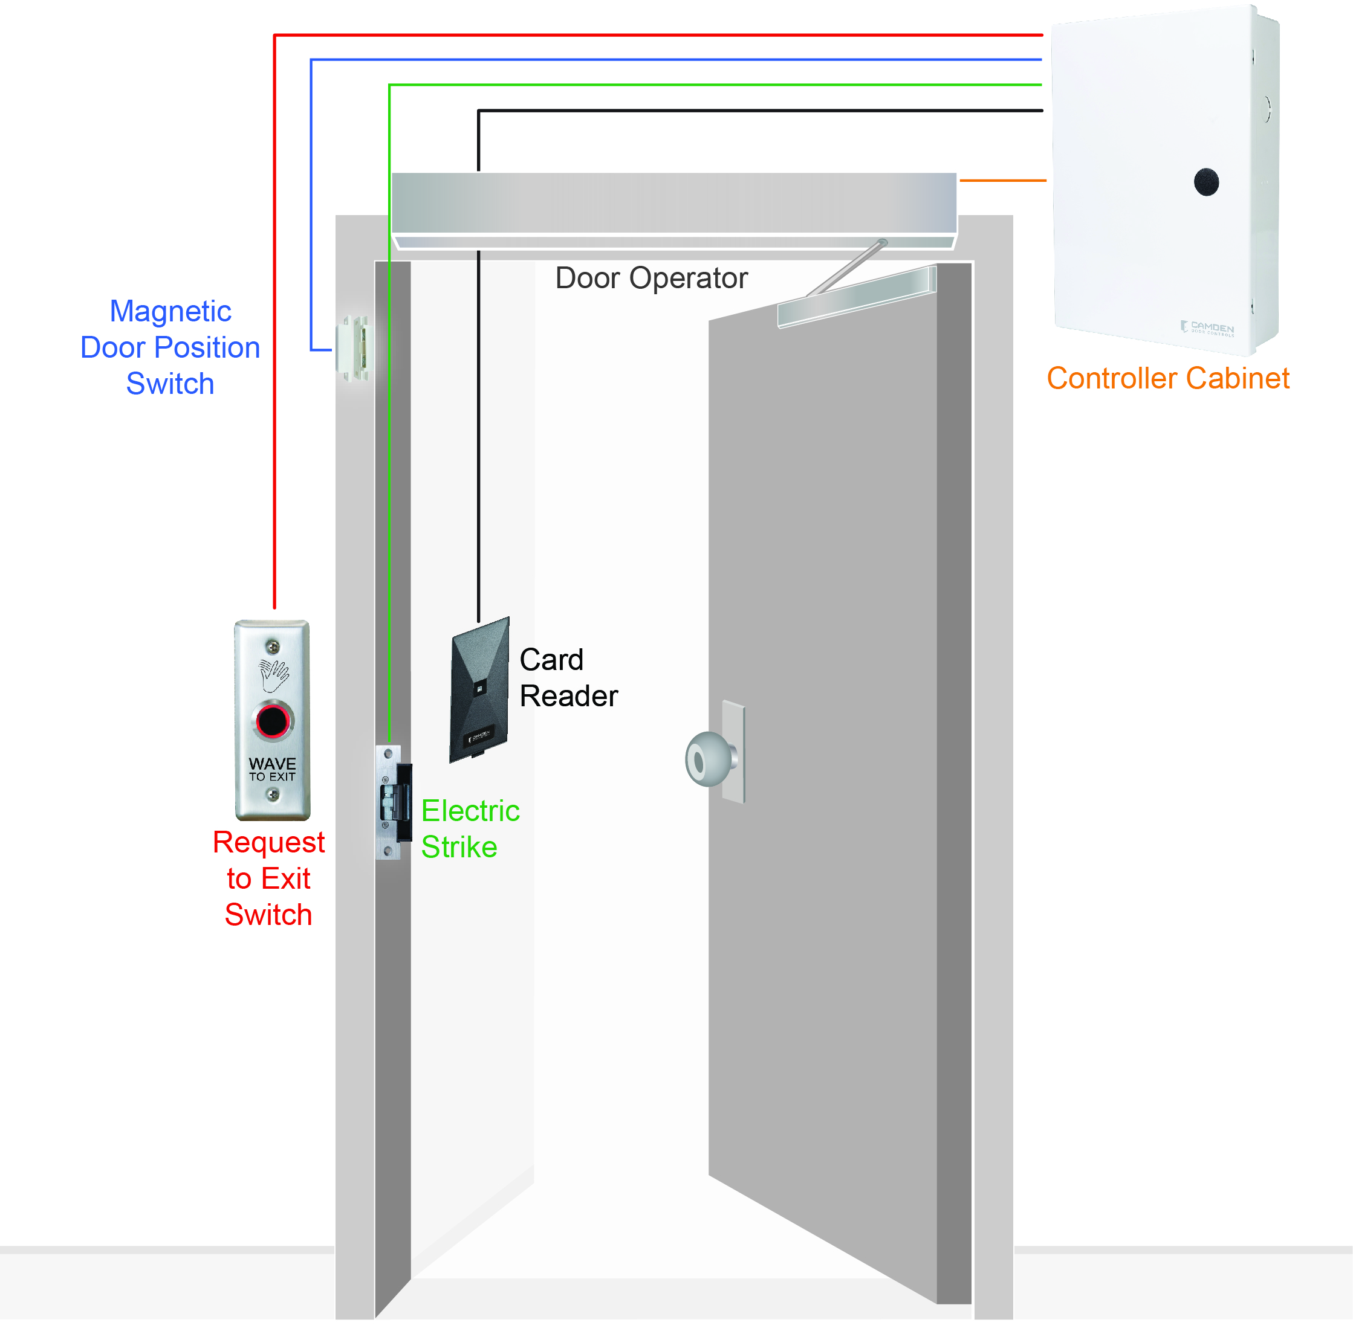
CV-603 Controller controls all peripheral devices for today’s access point.
Wiegand Card Reader
Door Strike or Maglock
Door position switch
Request to exit switch
Automatic Door Operator CX-12 module ordered separately
Local Alarm Annunciator CM-AF501SO or CM-AF140
Notes:
By adding our isolation relay module, it is possible to provide form C contacts to a digital communicator or connect to an intrusion panel input.
By adding our CX12 door control module inside the cabinet, you can control an automatic door operator with an electric strike for no contact solutions.

Slide 10
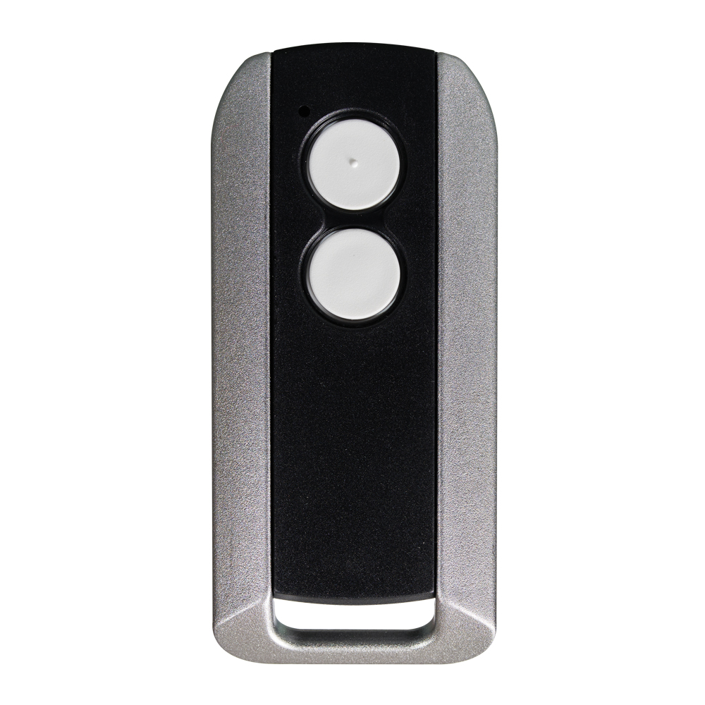
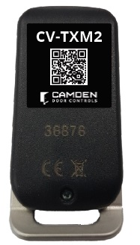
BUILT-IN WIRELESS RECEIVER
433 Mhz. wireless receiver with AES 128 encryption
Reliable up to 100 feet range for parking applications
CV-TXM2 two button transmitter uses a readily available CR2032 coin battery
Notes:
Extremely durable metal case for long term reliability. Etched, not printed ID number on case to ensure long term legibility.
Hard anti-pass back feature available to prevent tail gating. App lets you reset the anti-pass back. Group feature can bypass anti-pass back and/or conditioning.

Slide 11
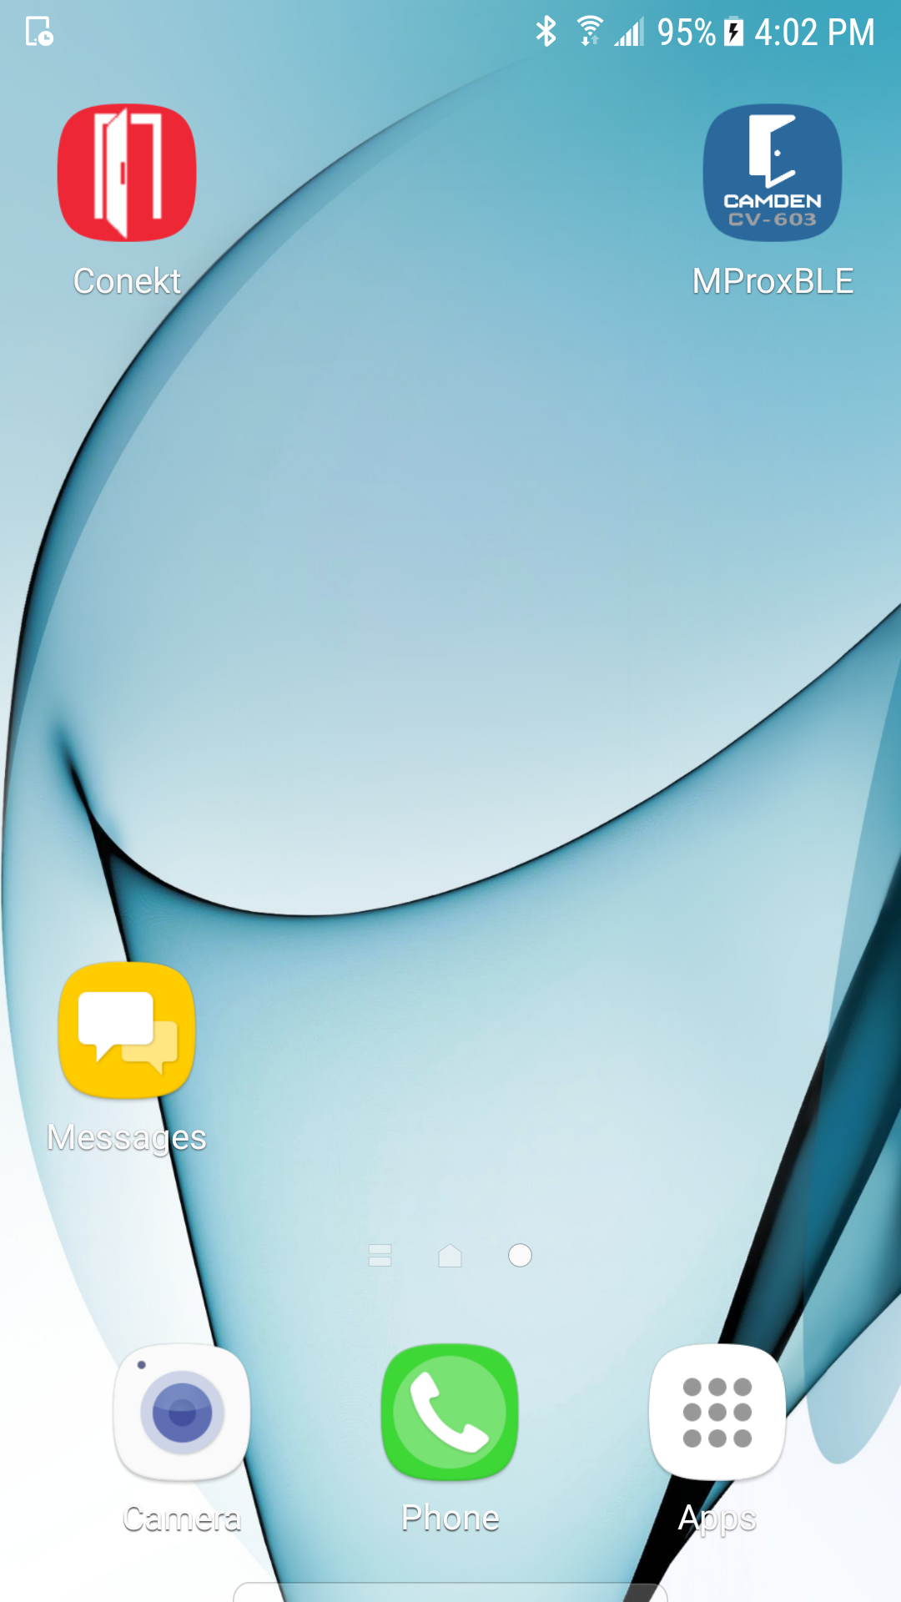
First time connecting
Configured & data entered
Tap image to play video
Tap image to play video
Notes:
Tap on MProxBLE icon to open app after downloading from Google Play or the Apple Store.
Uninitialized = First time connecting. Initialized = the controller is configured and the user data has been entered.
Under a minute to start working with the controller.

Slide 12
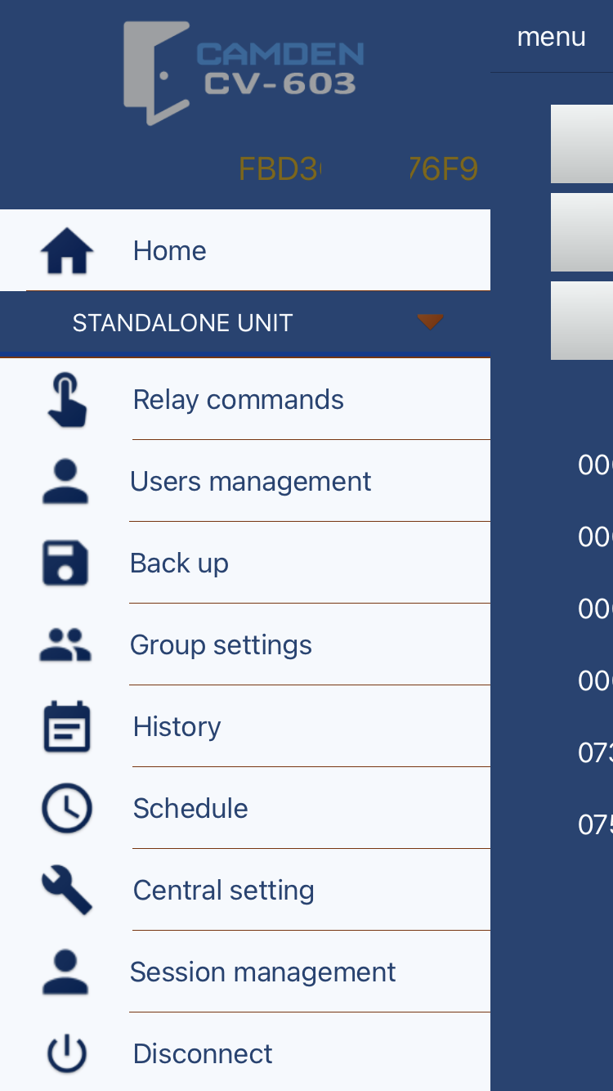
MAIN MENU
Relay Commands - Door control and alarm annunciation
User Management - Add User ID and information
Back Up - Save site file, export and import CSV files
Group Settings - Group users with common schedules or permissions
History - Review and save activity
Schedule - 8 schedules, 12 holidays, 12 Special days
Central Setting - Common site information
Session Management - Five administration levels, passwords.
Notes:
Central Setting = Equipment Name, Anti-pass back, Daylight savings time, credential facility code.
Session Management = Select what information each 5 users see when they log in. User Management, Backup, History, Relay Commands, Schedule, Group Settings.

Slide 13
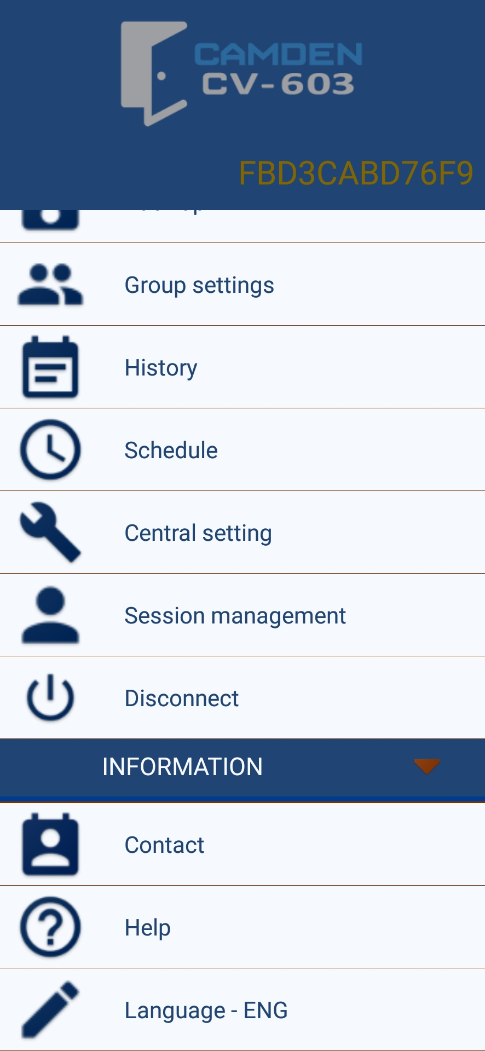
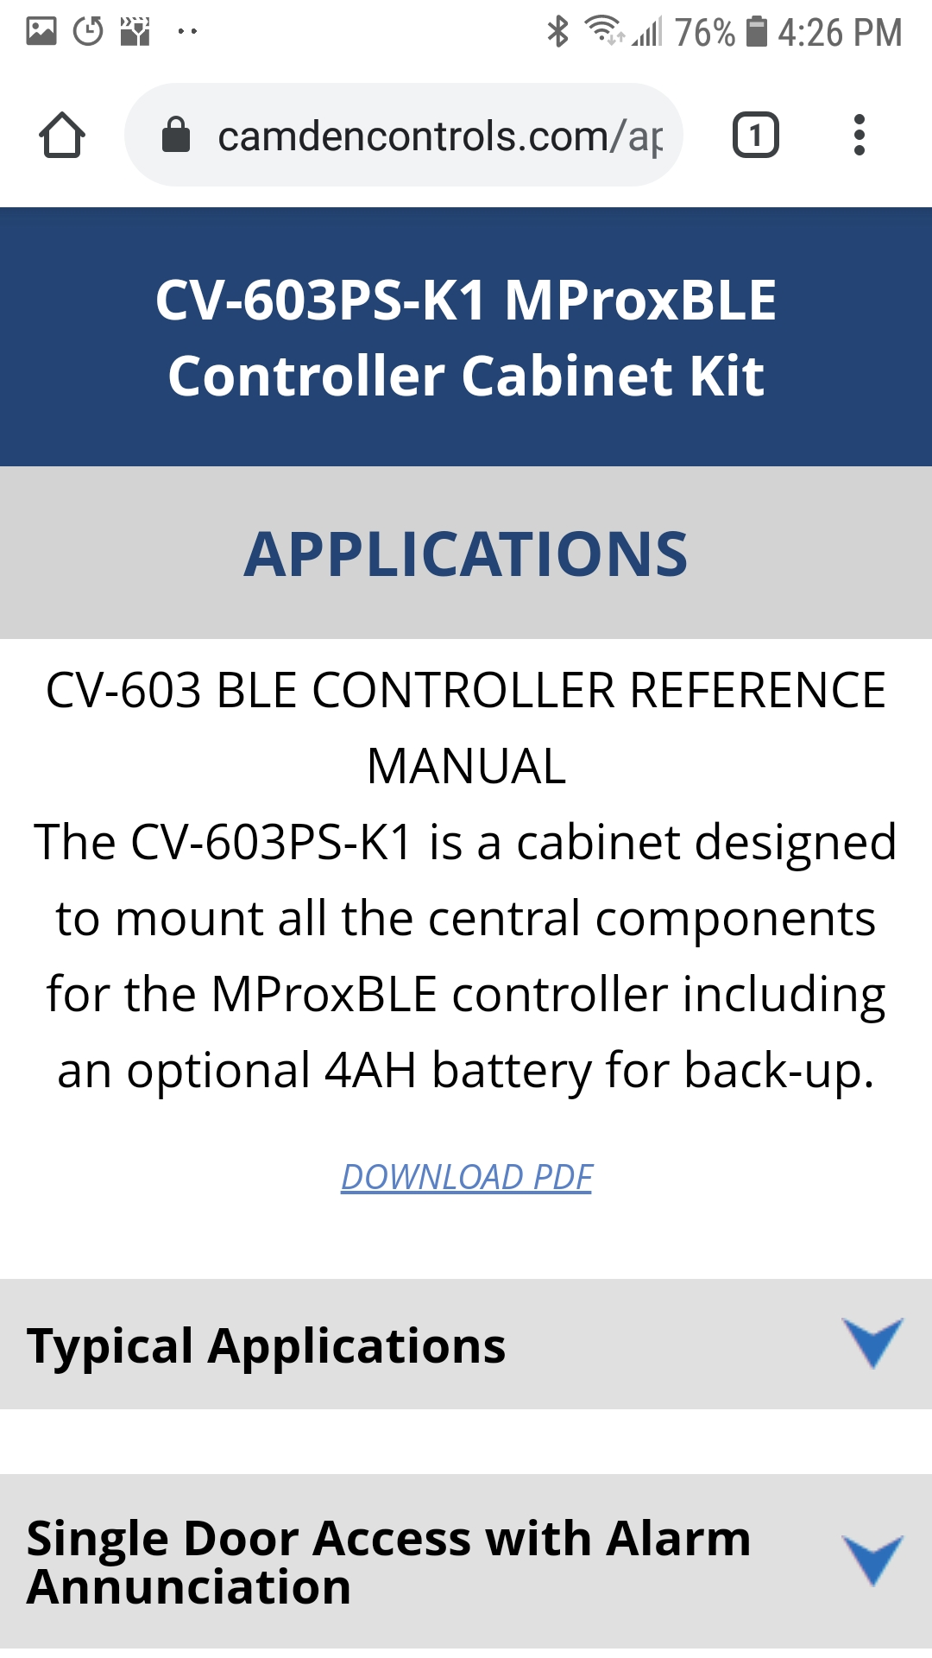
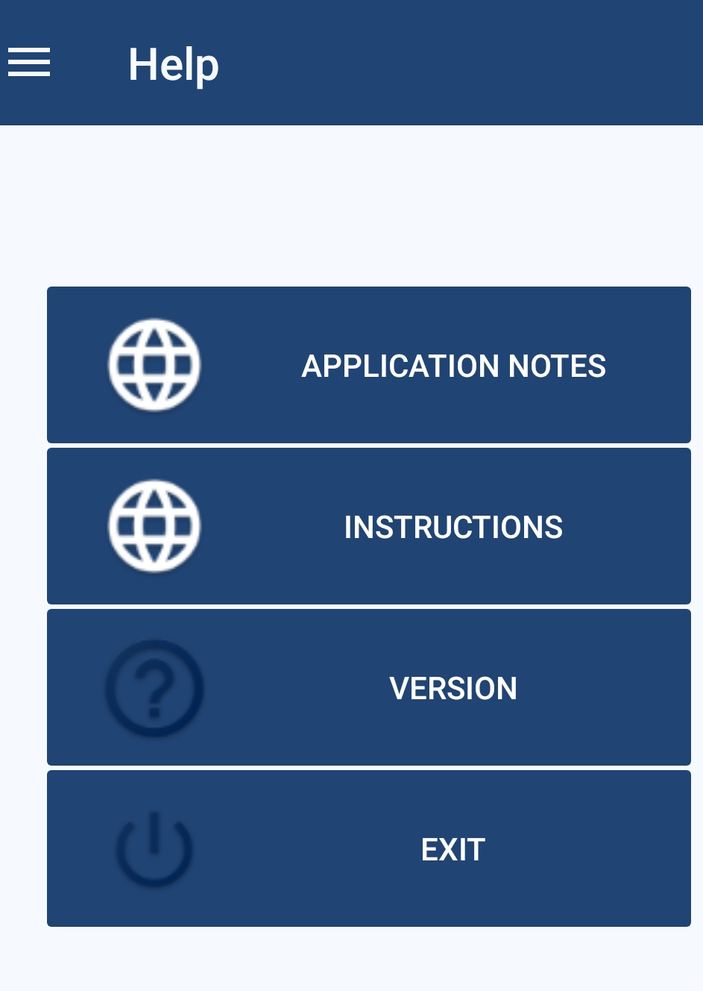
APPLICATION DOCUMENT
ACCESS VIA THE APP
2
3
1
Notes:
Bottom of the main menu = Information section for manual and application guides.
Explore the application section to get a point to point wiring dwg, BOM and detailed system description. Applications include; (1) single door with alarm annunciation, (2) single door with call for assistance and alarm, (3) single door contactless solution, (4) two door, and (4) vehicle IN/OUT gate application.

Slide 14
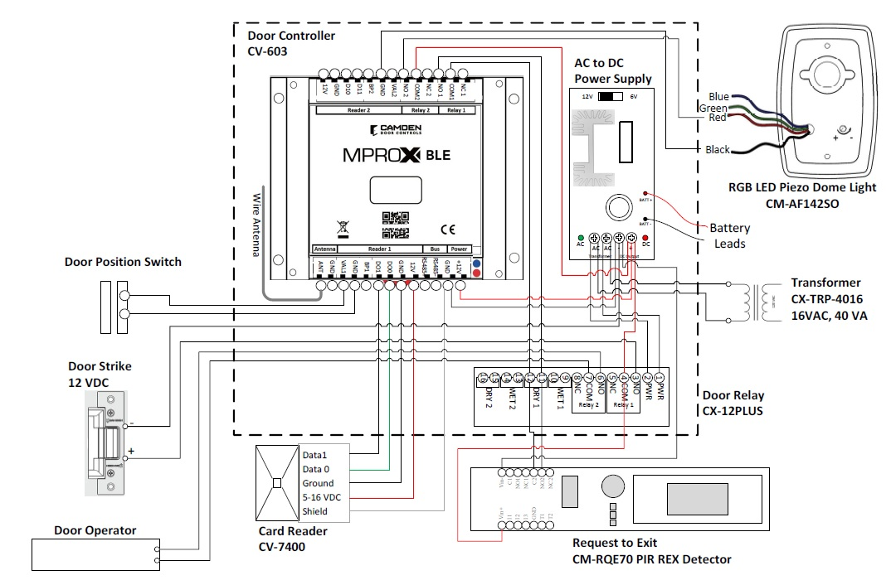
WIRING DIAGRAM
Notes:
Bottom of the main menu = Information section for manual and application guides.
Explore the application section to get a point to point wiring dwg.

Slide 15
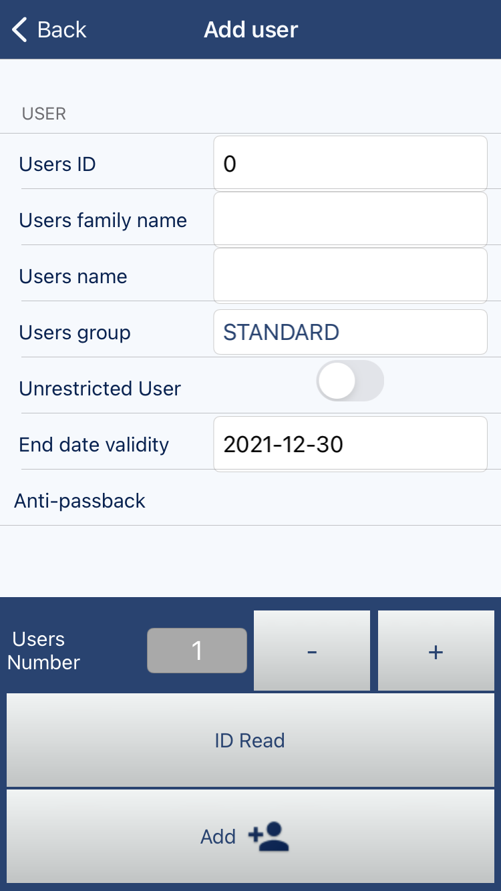
USER MANAGEMENT
Simply enter the user information for the specific credential ID number
ID Read - Automatically enrolls ID number
Batch add - Sequentially add a batch of credential ID numbers
Notes:
Groups = Lets you group a set of users to specific schedules and permissions.
End date validity = Automatically expire a user’s credential by date for temporary guests or trades etc.
Anti-pass back = For a higher level of security to prevent users from sharing their credentials. BUT the user must tap in AND out when using this feature. Typically used for parking applications.
Credentials – Manually or automatically by ID read icon, batch loading sequential IDs, easy search by name or ID capability. ONLY one FC# if activated; 34
Groups – by type (badge and/or transmitter, schedule and relay, and bypass for vehicle position and/or anti-passback

Slide 16
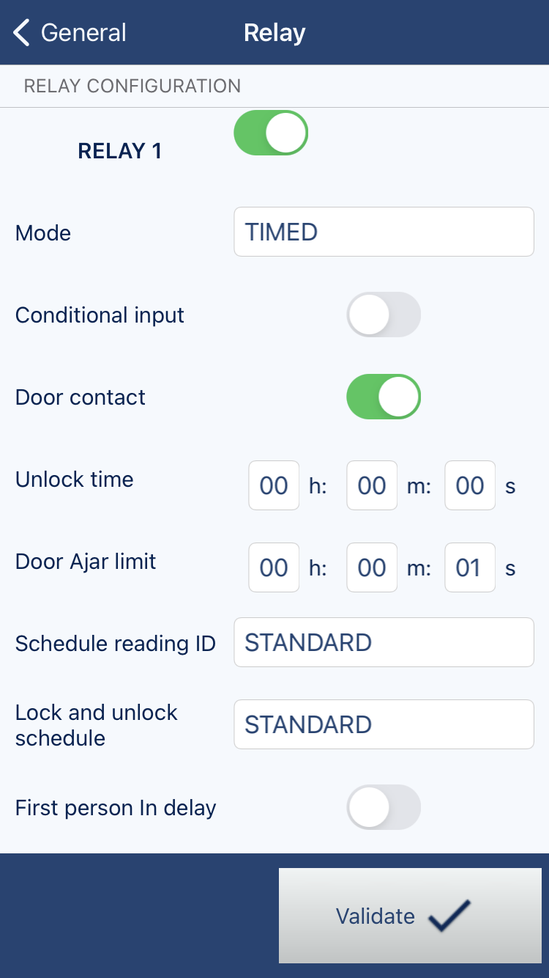
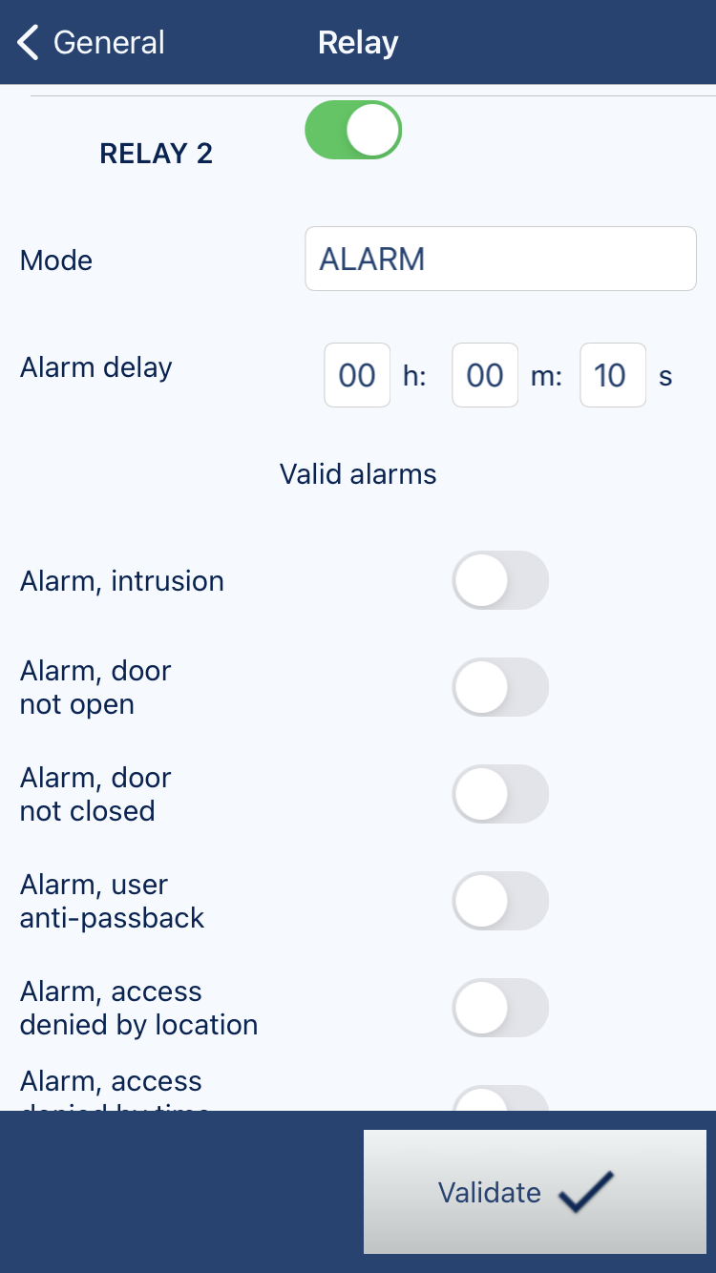
INPUT / OUTPUT CONFIGURATIONS
Conditional Input
Door Forced Open
Door Ajar
Lock and Unlock Schedule
First Person In Delay
Alarm Shut off Period
Notes:
Conditional Input: To activate the VAL controller input to monitor a loop detector to validate a vehicle is directly in front of the gate before opening.
Door Contact: Turning this on will enable ‘door forced open’ and ‘door ajar’ alarms.
Lock and unlock Schedule: Enables the door or gate to automatically open following a schedule.
First Person In Delay: Ensures the door or gate does not automatically open until a valid credential is read.
[Relay 2] Alarm Shut off Period: If an audible devices is wired to relay 2, it will automatically reset itself after this period if no manual reset from the app is done.

Slide 17
EXTENSIVE ACCESS CONTROL CAPABILITIES
Simple and Easy Access Control – No networking required.
Built-in receiver to accommodate encrypted transmitters.
Backup, import and export capabilities
History reports can be archived
Compatible to most card readers – Wiegand format
Cabinet kits available including battery back up power supply
Library of point-to-point application wiring diagrams.

Slide 18
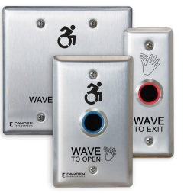
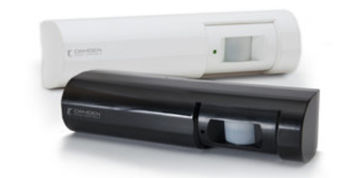
ValueWave™ Touchless Switches
The Industry’s
Most Extensive Range of Contactless & Frictionless
Door Access Control
Bluetooth Card Reader
Long Range Transmitter
‘Request to Exit’
Detectors

Slide 19
Questions & Answers

